Slide 1




Advance Care
Planning

Slide 2
Advance Care Planning
A process where you discuss and plan for the care you would want to receive if you are unable to make decisions for yourself.
​Share the information with loved ones and put your wishes in writing.

Slide 3
Why is advance care planning important?
We are a society of planners. We plan for marriage, a baby, college and even retirement but most don’t prepare for the end of life.
Advance care planning helps your loved ones and health care providers honor your goals of care and wishes if you are unable to speak for yourself.
If you ever have an accident, stroke, surgery, or are diagnosed with a serious illness you may need someone to advocate for your wishes.

Slide 4


Slide 5
Advance Care Directives
Living Will
Health Care Power of Attorney (HPOA)
MOST (medical order for scope of treatment)
DNR (do not resuscitate)

Slide 6
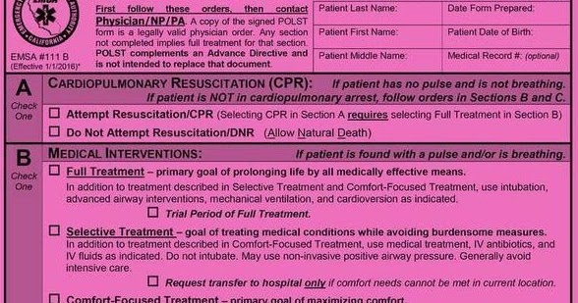
MOST Form

Slide 7
Living Will
In North Carolina a Living Will allows you to state your desire NOT to receive life-prolonging measures in any or all of the following situations:
You have an incurable condition that will result in death within a short period of time.
You are unconscious, and your doctors are confident that you will not regain consciousness.
You have advanced dementia or other substantial and irreversible loss of mental function.

Slide 8
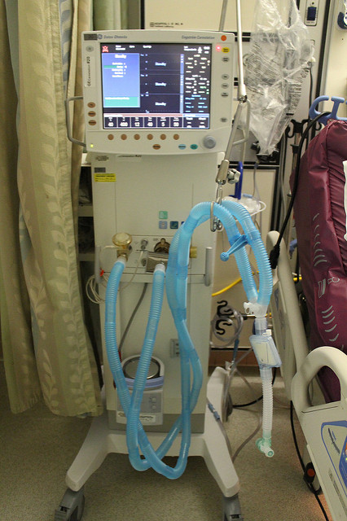
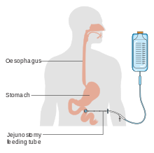

What are life-prolonging measures?
Life-prolonging measures are any medical treatments that would only serve to postpone death such as:
Breathing machines (ventilator)
Kidney Dialysis
Antibiotics
Tube Feedings or Artificial Hydration such as IV’s

Slide 9
What if I want Tube Feedings or artificial hydration?
Express your wishes to receive these treatments.
Initial the statement in Section 2 of Part B in the document.

Slide 10
Health Care Power of Attorney (HPOA)
A health care power of attorney is a legal document in which you name another person, called a “health care agent or health care proxy”, to make decisions for you when you are not able to make those decisions yourself.

Slide 11
Who can be a health care agent?
Any competent person who is at least 18 years old.
ONLY exception is your health care agent cannot be your paid health care provider.

Slide 12
How do I choose my health care agent?
Needs to be someone who knows you well
A person who is available and accessible to represent you when needed
A person who will honor your wishes
A person not afraid to stand up for you in the event your wishes differ from other family members

Slide 13
What authority does my HPOA have?
This is based upon the power you give them in the health care power of attorney documents. Section 2 of Part A of the health care power of attorney form allows you to limit the power of your decision maker.
If there are no limitations then your health care power of attorney can make ALL health care related decisions for you, including:
Access to your medical information
Make decisions about who provides your medical care
Give consent for test, procedures, treatments, and surgeries
Admit you to and discharge you from a health care facility
Withhold or withdraw any life prolonging measures
Authorize an autopsy
Direct the disposition of your body after death, including organ/ tissue donation

Slide 14
Organ and tissue donation after death
You can give your health care agent the power to donate your tissues and organs following death based on your expressed wishes.
You must initial the statement in Section 3 Part A on the health care power of attorney document in order to give the agent this power.

Slide 15
When does a health care power of attorney become effective?
Your health care power of attorney becomes effective when your doctor determines that you have lost the ability to make you own health care decisions.
It’s important to remember that regardless of when you completed your HPOA document, no one has the power to make health care decisions for you until such time as you lack the capacity to do it yourself.

Slide 16
What happens if I change my mind?
If you are competent, you may revoke your health care power of attorney document at any time.
You can void the document by writing void across the document, signing and dating for the date it was voided.
You can complete a new health care power of attorney document (the most recently completed HPOA document is the valid one).
Do not forget to notify your doctors or health care providers who have a copy of your old POA, that you have completed a new one and provide them a copy.

Slide 17
Who can stop life-prolonging measures if I do not appoint a health care agent?
A Court appointed Guardian
Spouse
Majority of reasonably available parents and adult children
Majority of reasonably available adult siblings
An individual who has an established relationship with the patient, who acts in good faith on behalf of the patient, and who can convey the patient’s wishes.
If none of the above is reasonably available then at the discretion of the attending physician, life-prolonging measures may be withheld or discontinued upon the discretion and under the supervision of the attending physician.

Slide 18
What is needed to complete my Advance Care Directives?
Two Witnesses (Non-Family)
We can use others here today for witnesses.
A Notary Public (provided on site today)
A valid ID
Your Signature

Slide 19

What is next after I complete my Advance Care Directives?
Put the original in a safe place
Make copies for your health care providers (Physicians, Home Health agency, Hospice, hospital, etc.)
Give a copy to your HPOA and share your wishes with your family

Slide 20

Questions?

